Slide 1
Comparison Unit for Fingerprinting in Multicore Redundant Systems
Harsh Aurora
29 July 2015

Slide 2
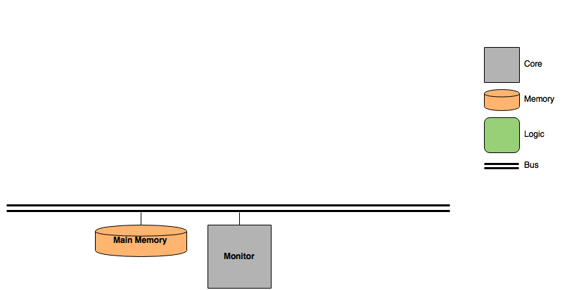
Hardware System Overview

Slide 3
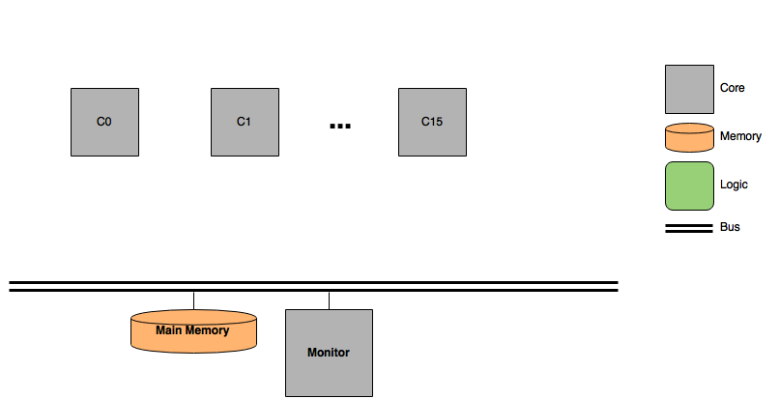
Hardware System Overview

Slide 4
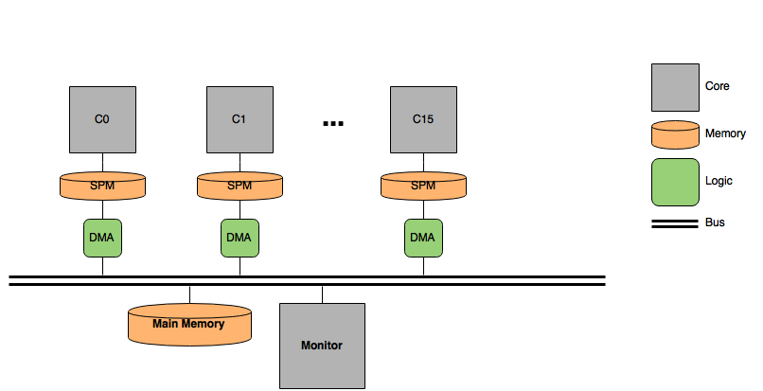
Hardware System Overview

Slide 5
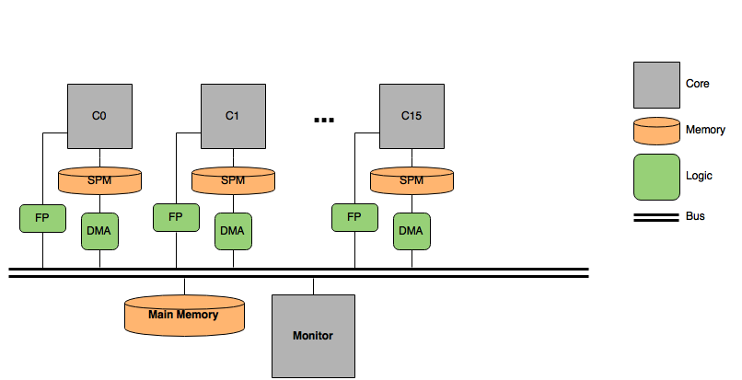
Hardware System Overview

Slide 6
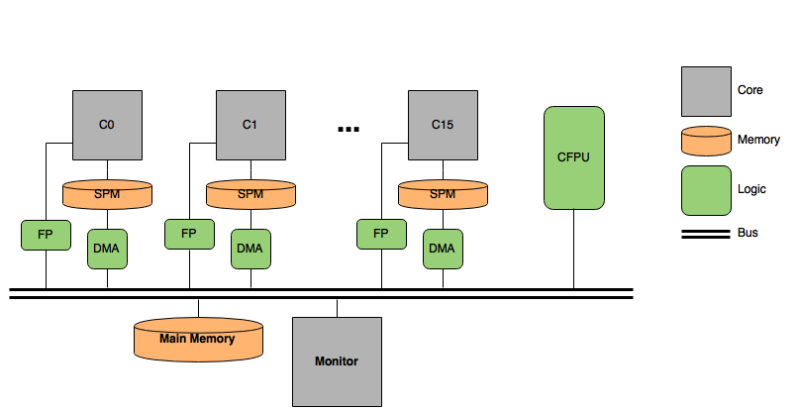
Hardware System Overview

Slide 7
Hardware System Overview
Existing system is implemented on an Altera Arria V FPGA
There are only 8 physical cores (limited resources)
All transactions are carried out on the same bus, leading to interference
As a result, some cores are granted bus access more frequently than others

Slide 8

CFPU

Slide 9
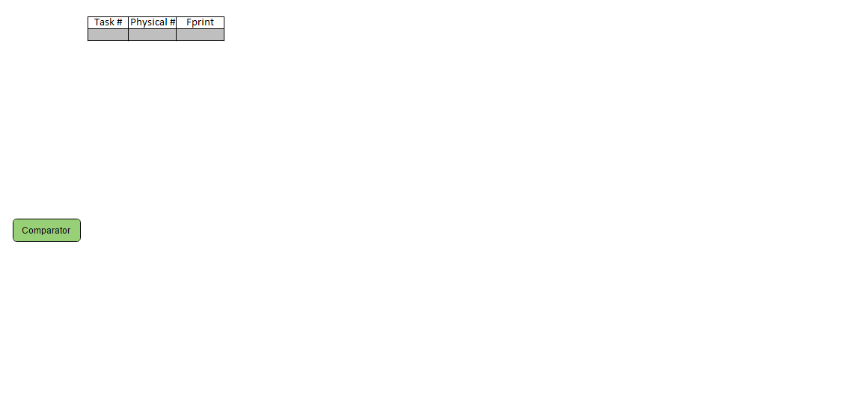
CFPU

Slide 10
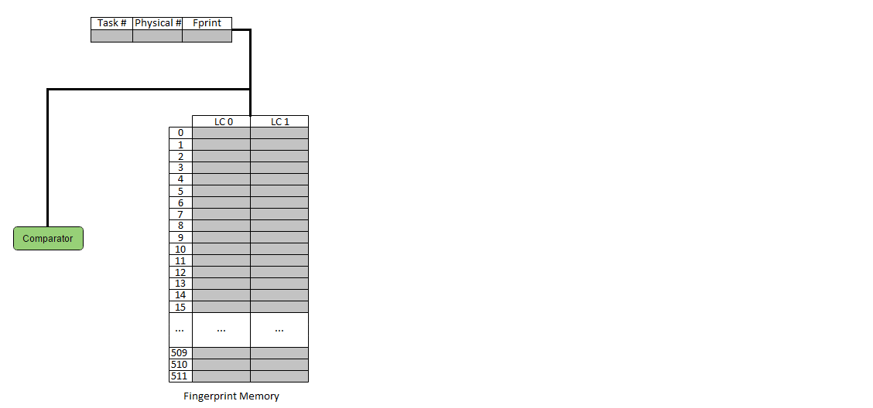
CFPU

Slide 11
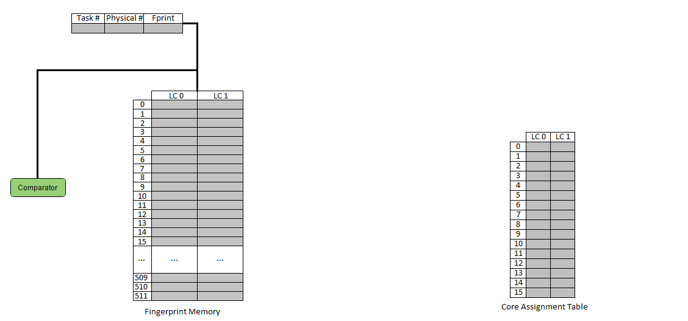
CFPU

Slide 12
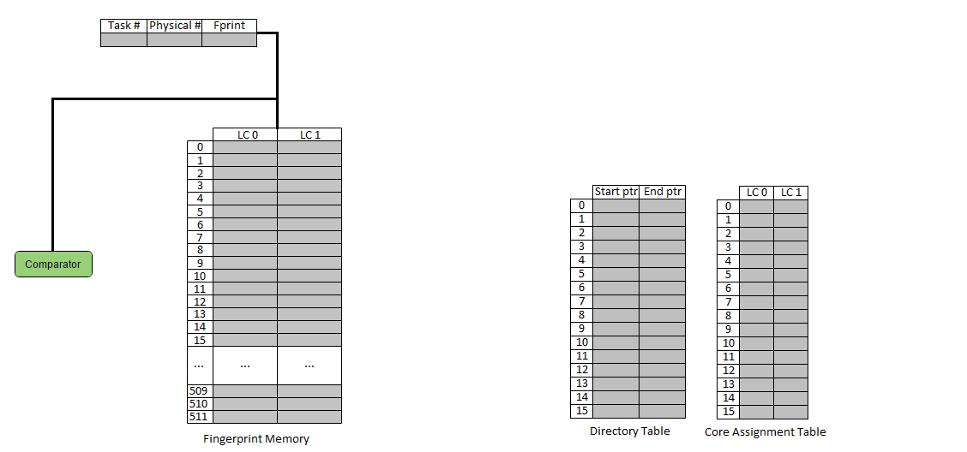
CFPU

Slide 13
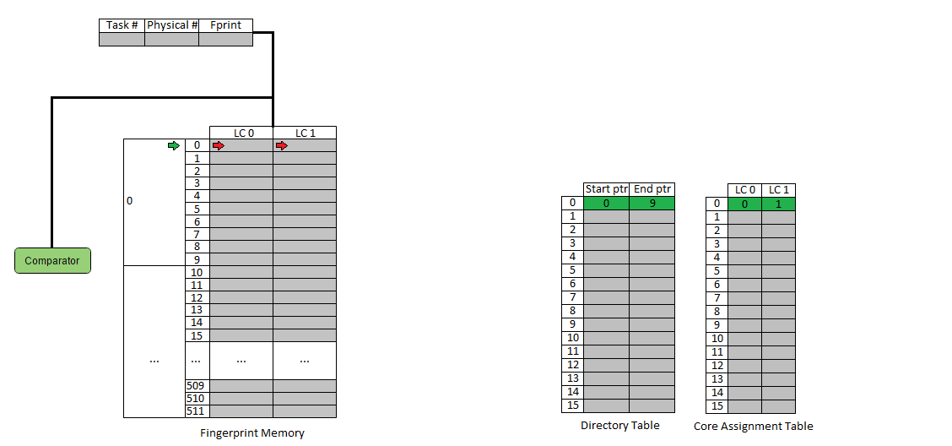
CFPU

Slide 14
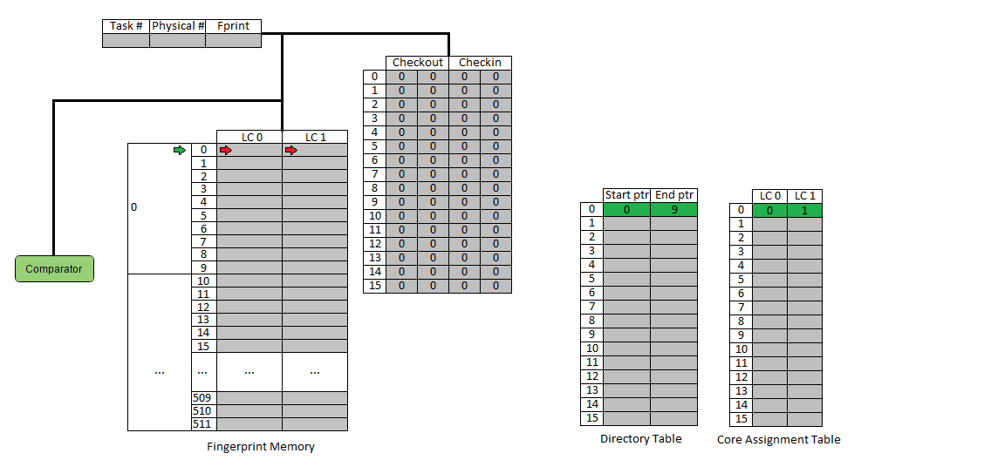
CFPU

Slide 15
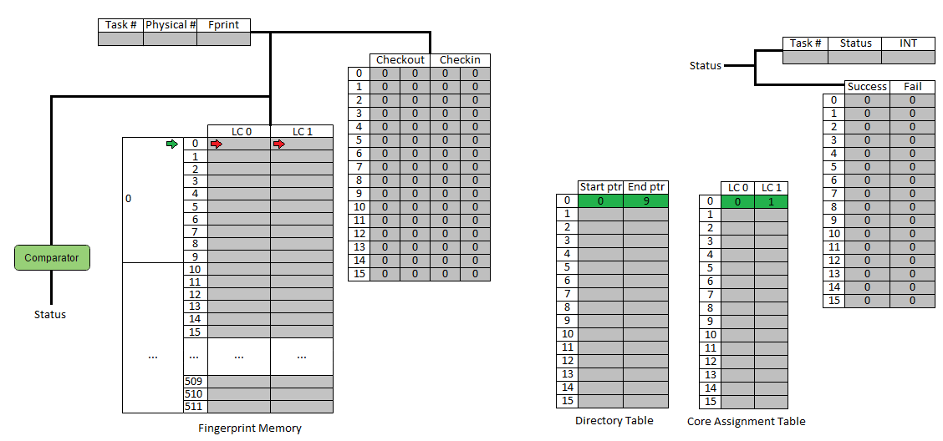
CFPU

Slide 16
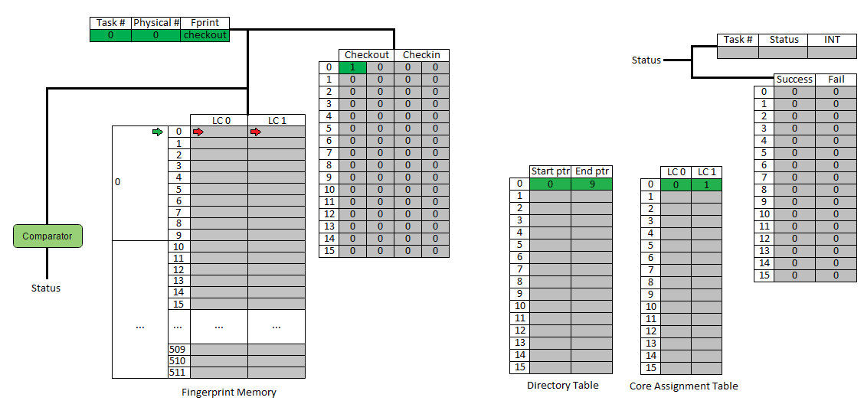
CFPU

Slide 17
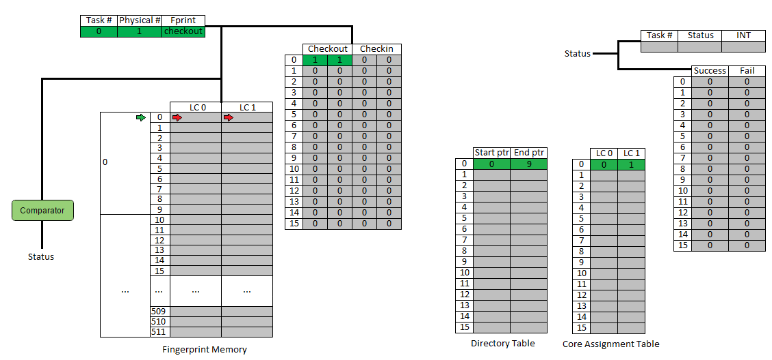
CFPU

Slide 18
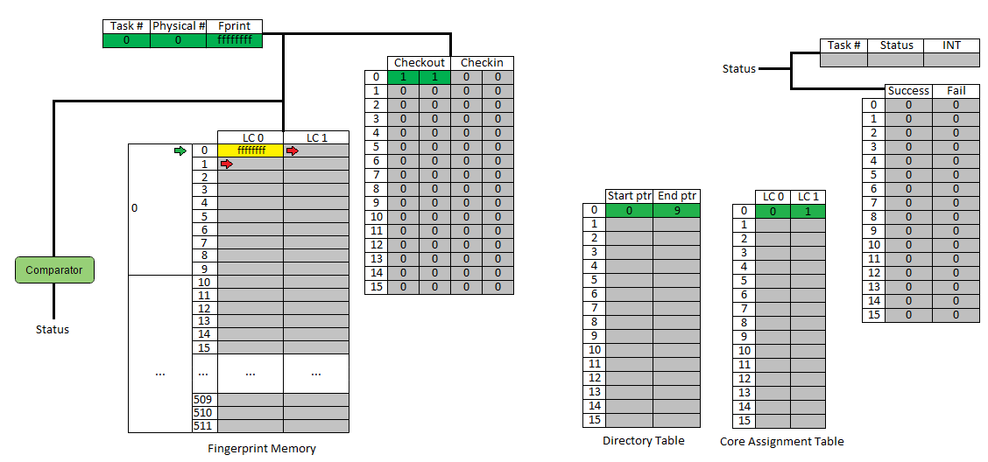
CFPU

Slide 19
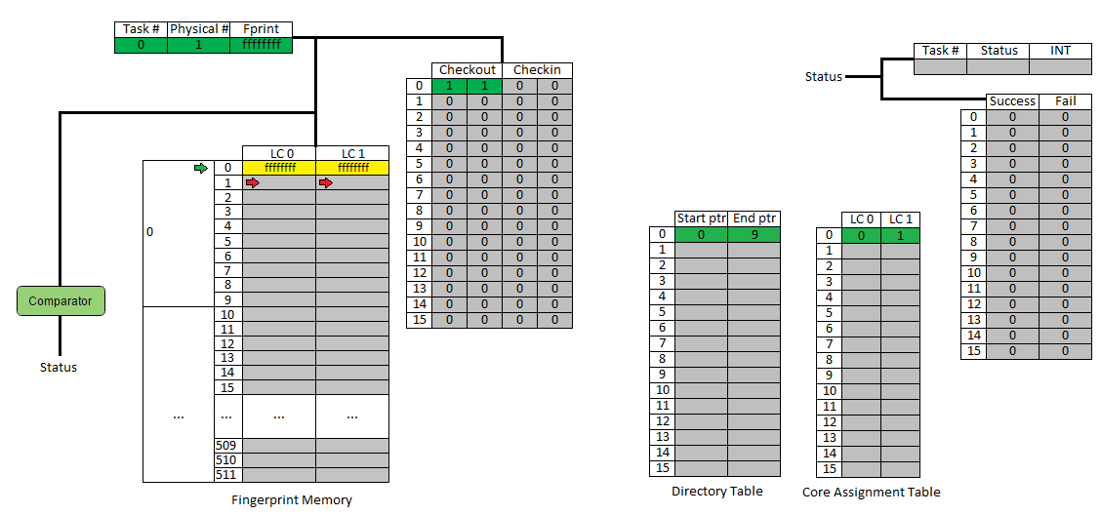
CFPU

Slide 20
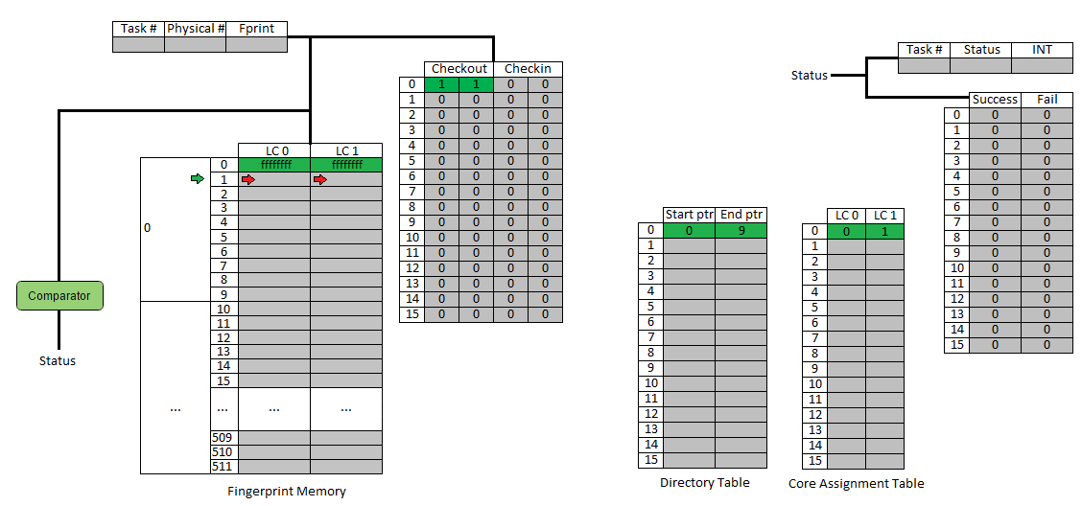
CFPU

Slide 21

CFPU

Slide 22
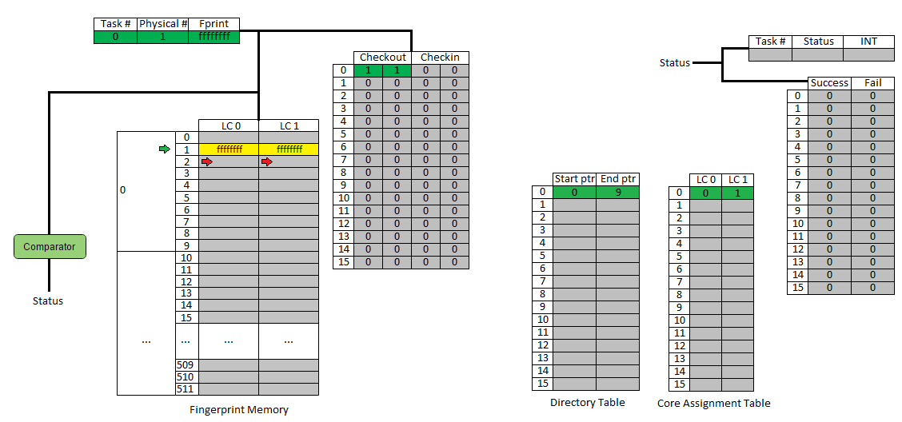
CFPU

Slide 23

CFPU

Slide 24
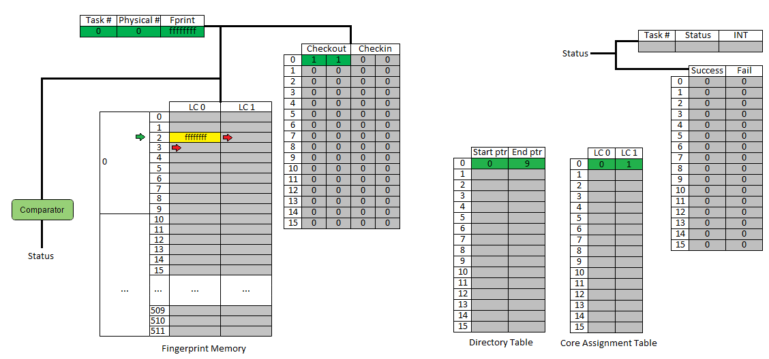
CFPU

Slide 25

CFPU

Slide 26
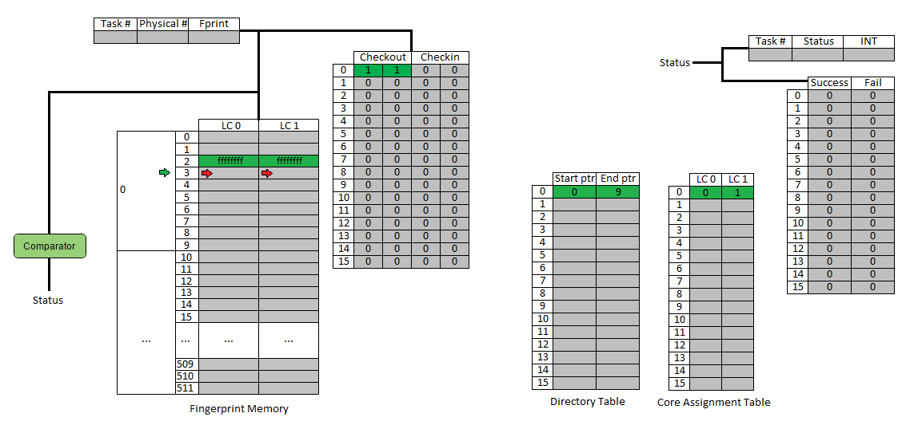
CFPU

Slide 27

CFPU

Slide 28
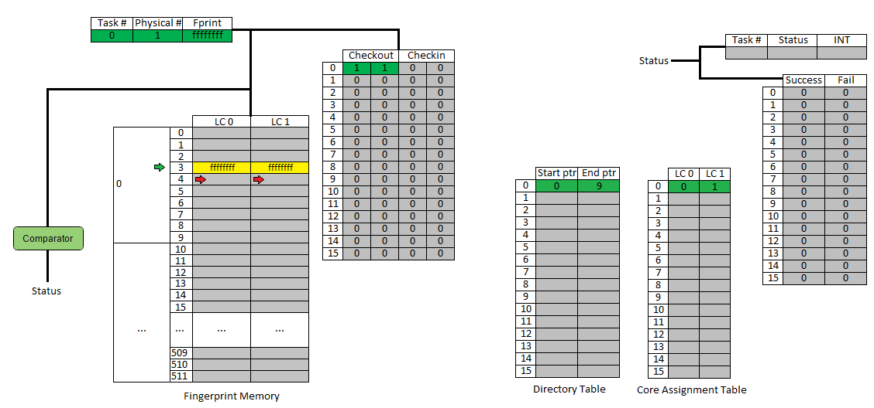
CFPU

Slide 29
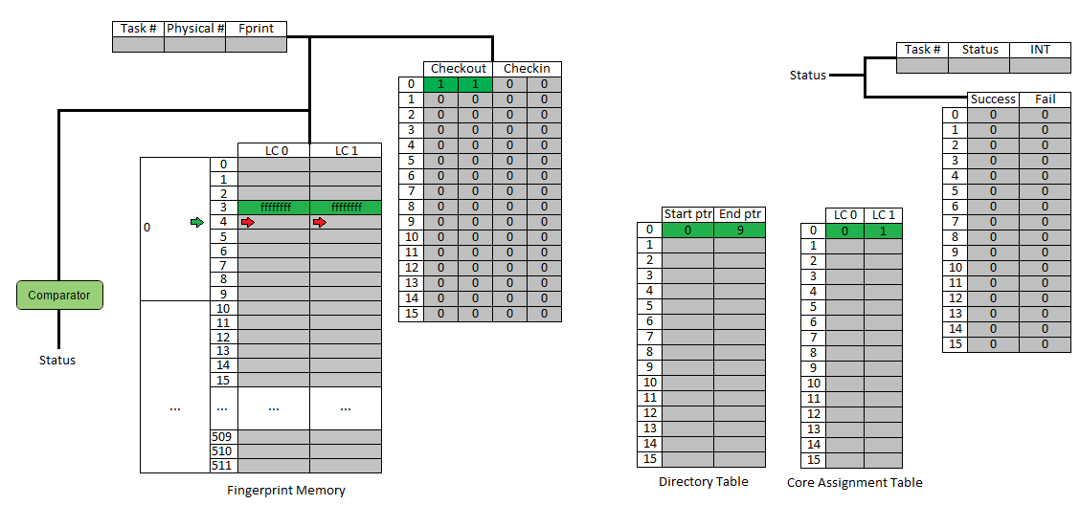
CFPU

Slide 30

CFPU

Slide 31
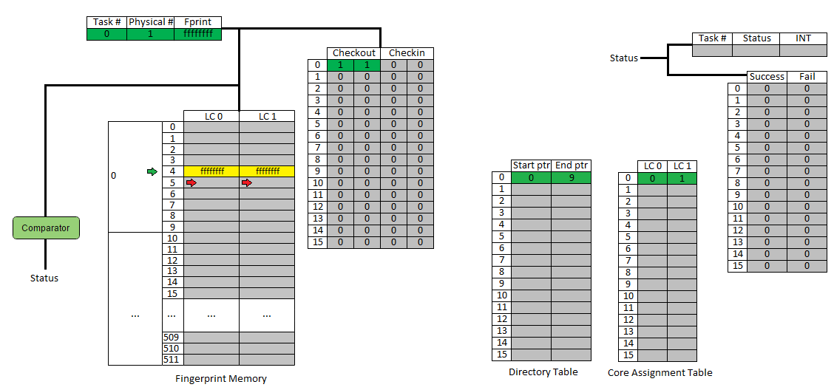
CFPU

Slide 32

CFPU

Slide 33
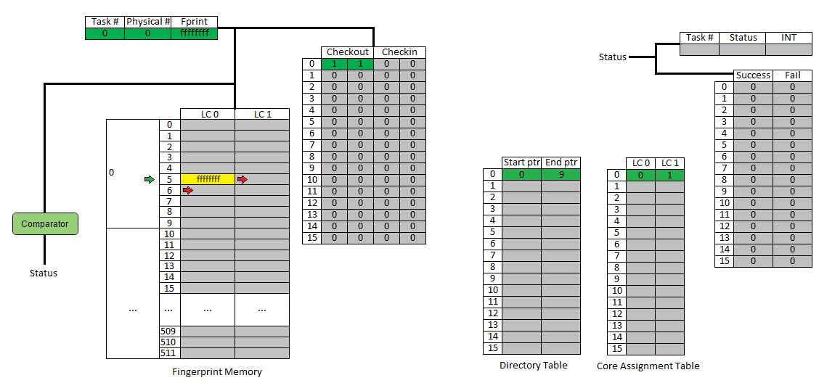
CFPU

Slide 34

CFPU

Slide 35
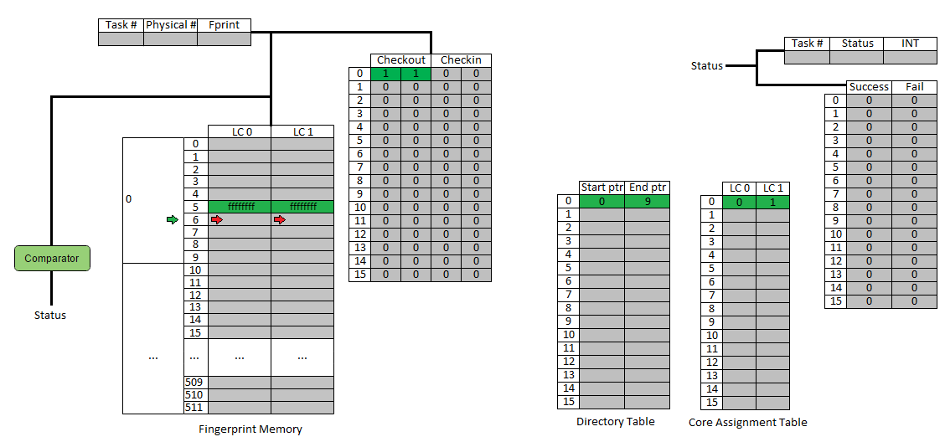
CFPU

Slide 36

CFPU

Slide 37
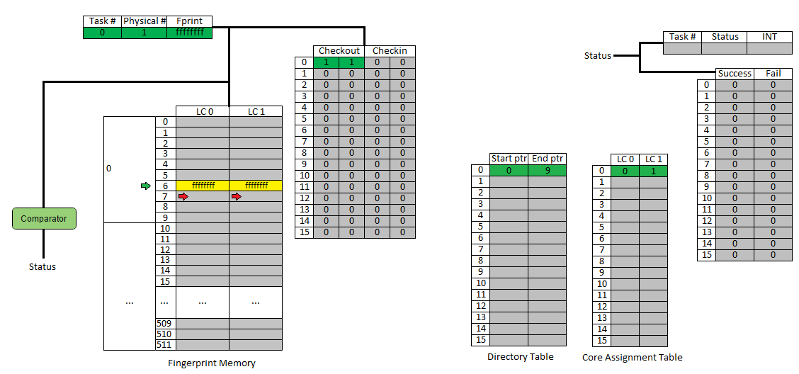
CFPU

Slide 38
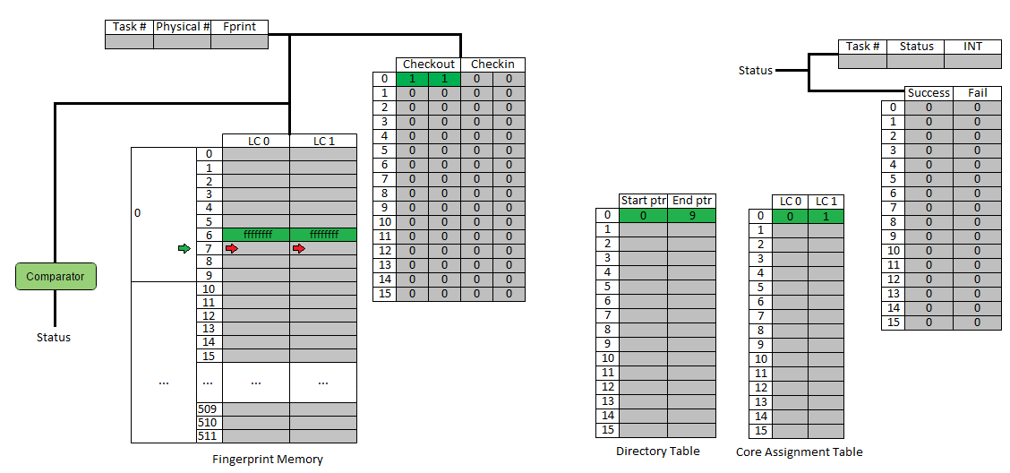
CFPU

Slide 39

CFPU

Slide 40
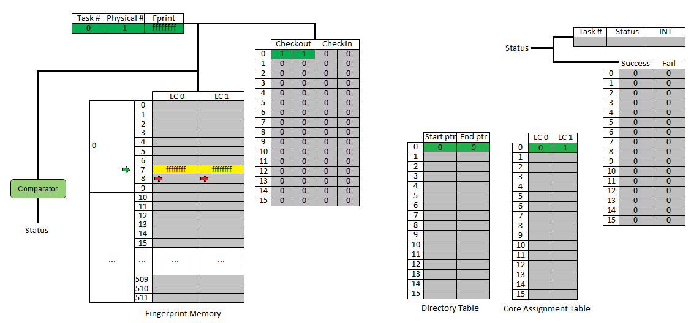
CFPU

Slide 41
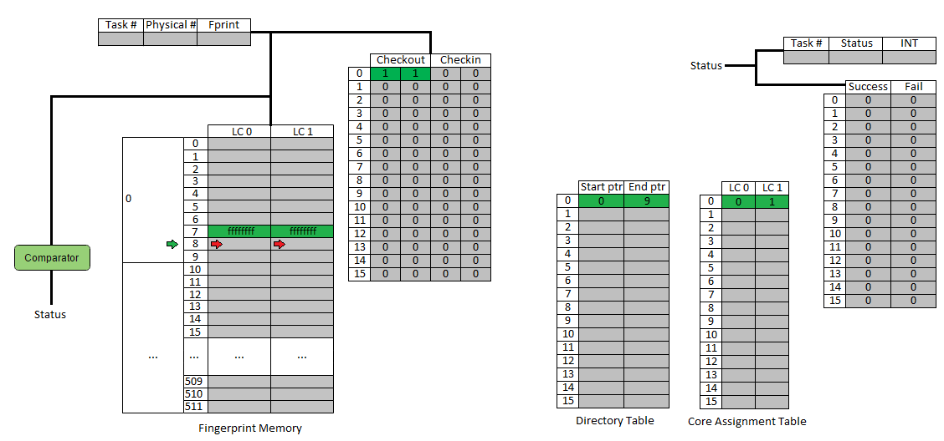
CFPU

Slide 42
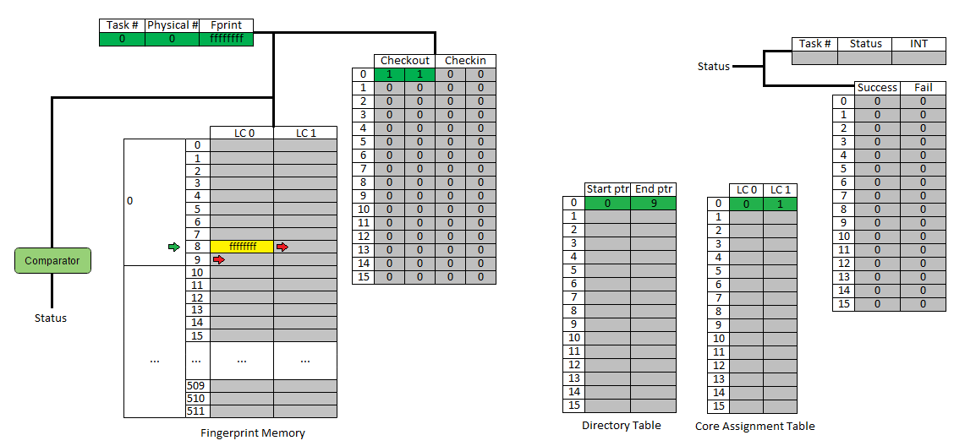
CFPU

Slide 43
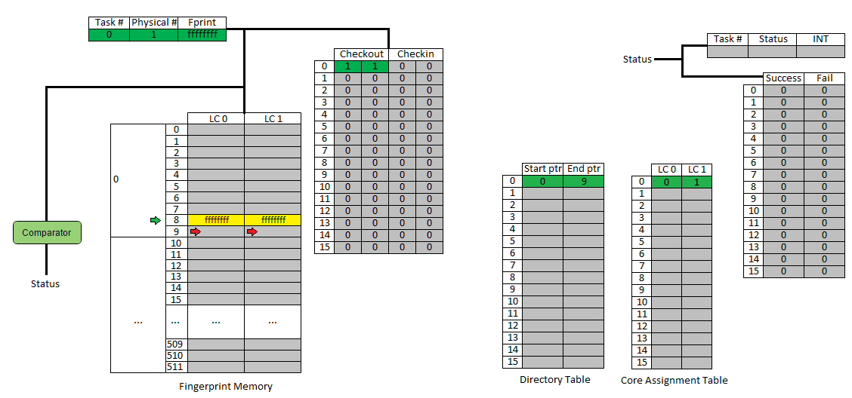
CFPU

Slide 44

CFPU

Slide 45

CFPU

Slide 46

CFPU

Slide 47
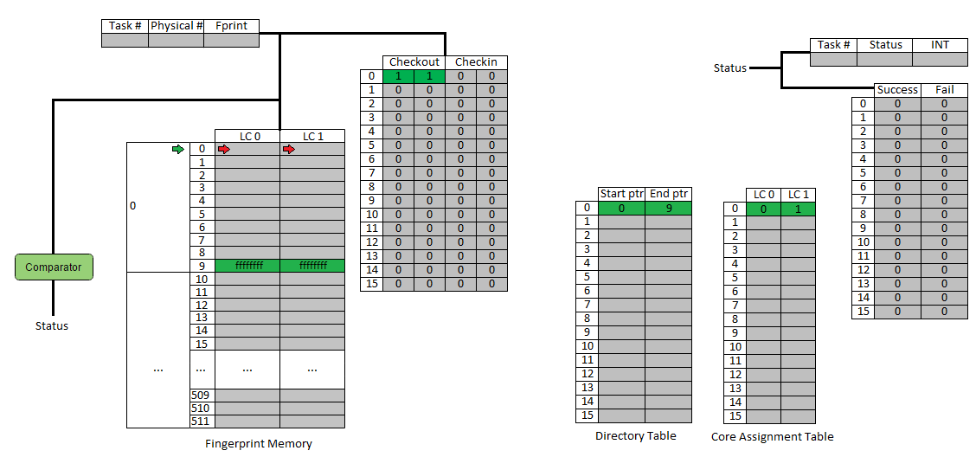
CFPU

Slide 48
CFPU

Slide 49
CFPU

Slide 50
CFPU

Slide 51
CFPU

Slide 52
CFPU

Slide 53
CFPU

Slide 54
CFPU

Slide 55
CFPU

Slide 56
CFPU

Slide 57
CFPU

Slide 58
CFPU

Slide 59
CFPU

Slide 60
CFPU

Slide 61
CFPU

Slide 62
CFPU

Slide 63

CFPU

Slide 64
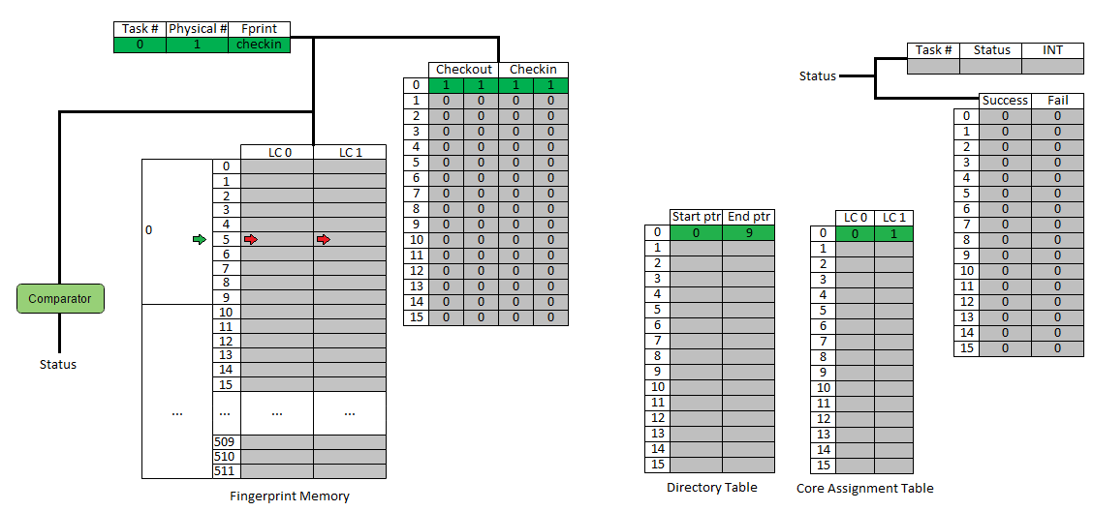
CFPU

Slide 65
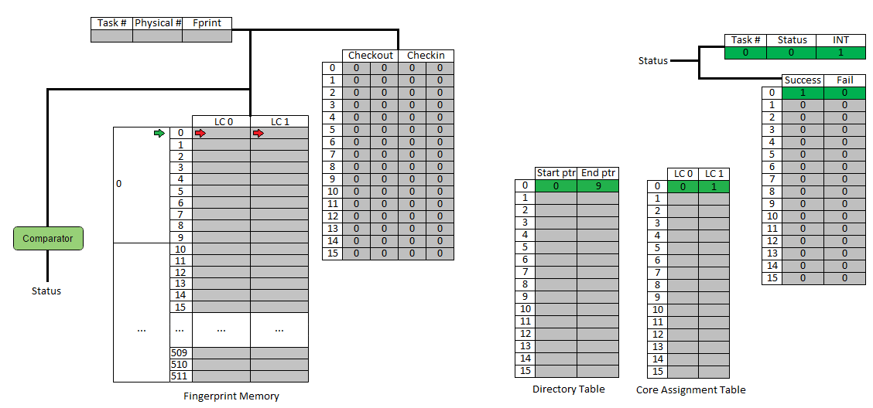
CFPU

Slide 66
CFPU

Slide 67
CFPU

Slide 68
CFPU

Slide 69
CFPU

Slide 70
CFPU

Slide 71
CFPU

Slide 72
CFPU

Slide 73

CFPU

Slide 74
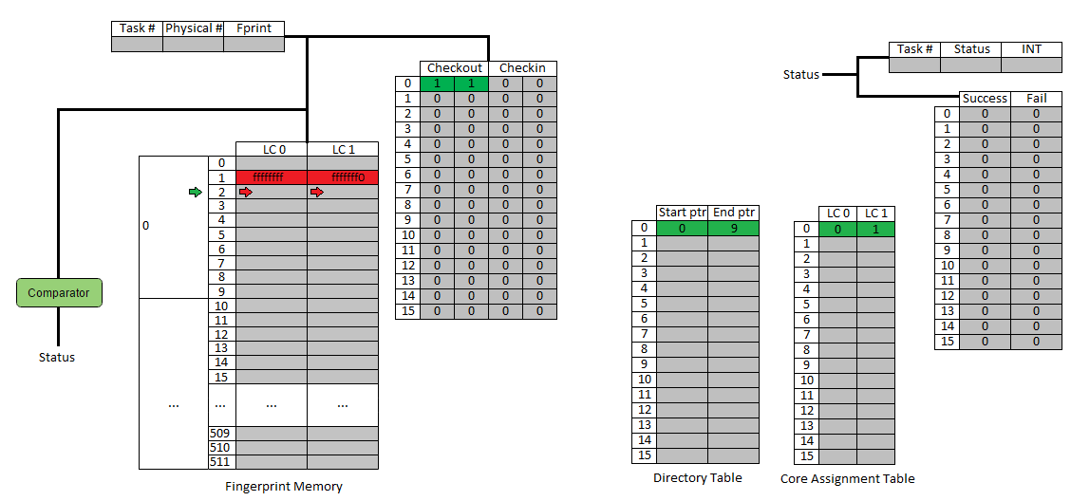
CFPU

Slide 75
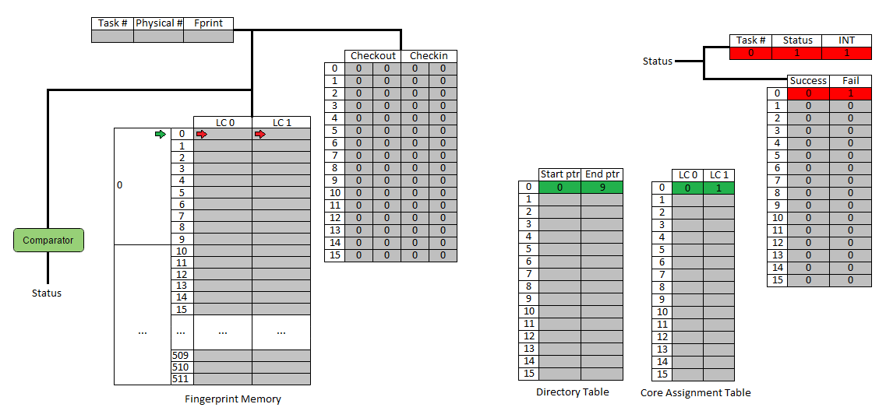
CFPU

Slide 76
CFPU: What’s the problem?

Slide 77
CFPU: What’s the problem?

Slide 78
CFPU: What’s the problem?

Slide 79

CFPU: What’s the problem?

Slide 80
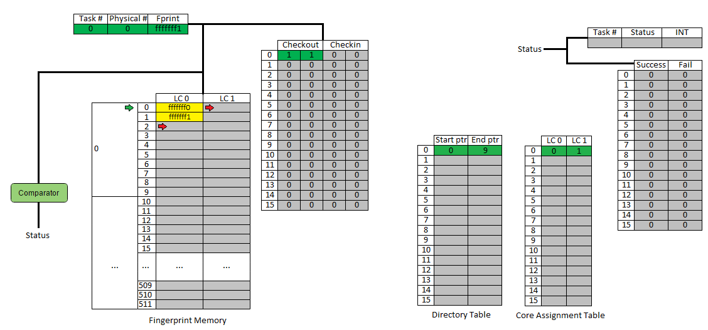
CFPU: What’s the problem?

Slide 81

CFPU: What’s the problem?

Slide 82
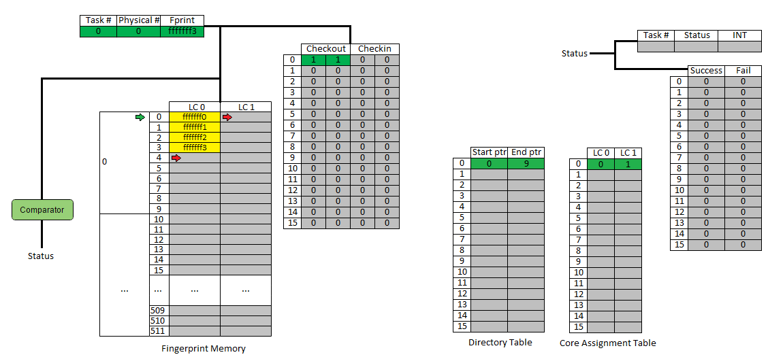
CFPU: What’s the problem?

Slide 83

CFPU: What’s the problem?

Slide 84
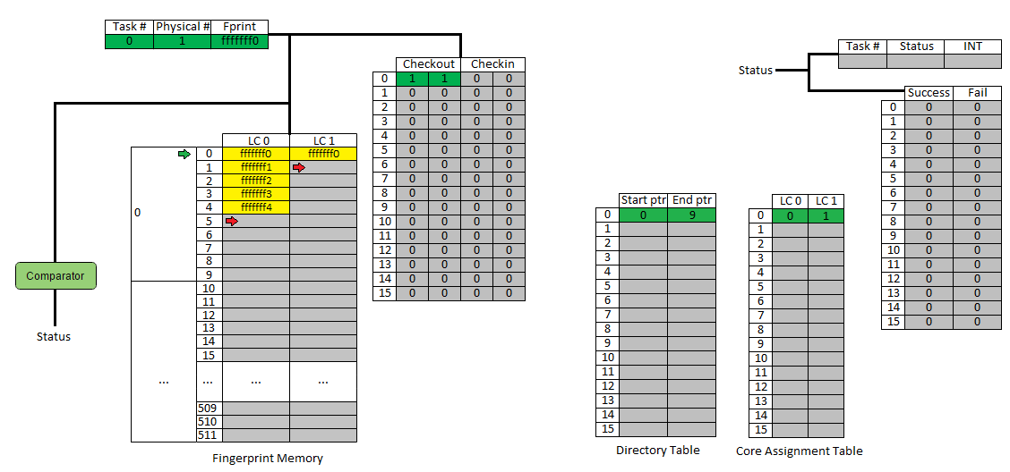
CFPU: What’s the problem?

Slide 85
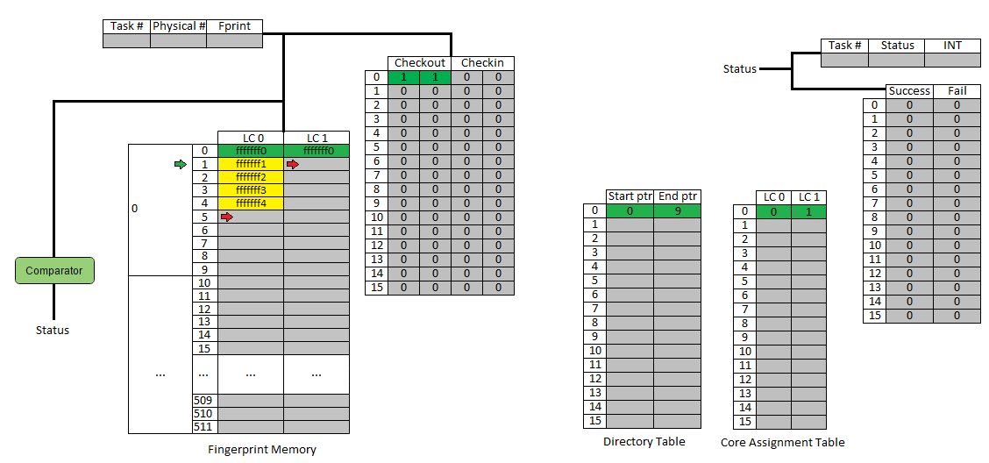
CFPU: What’s the problem?

Slide 86

CFPU: What’s the problem?

Slide 87

CFPU: What’s the problem?

Slide 88

CFPU: What’s the problem?

Slide 89

CFPU: What’s the problem?

Slide 90

CFPU: What’s the problem?

Slide 91

CFPU: What’s the problem?

Slide 92
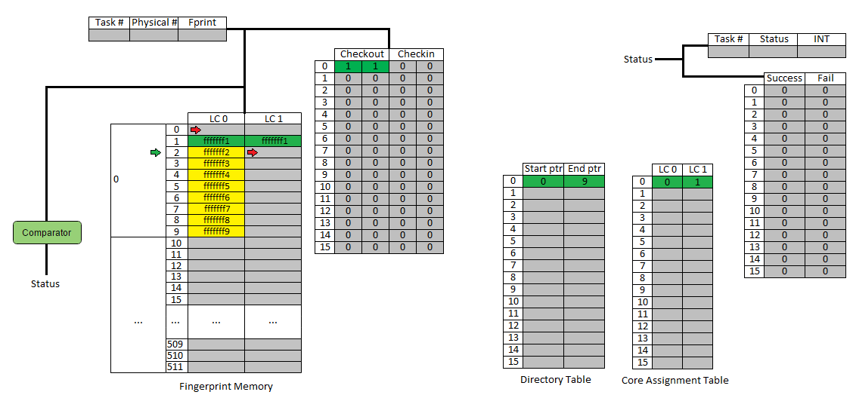
CFPU: What’s the problem?

Slide 93

CFPU: What’s the problem?

Slide 94
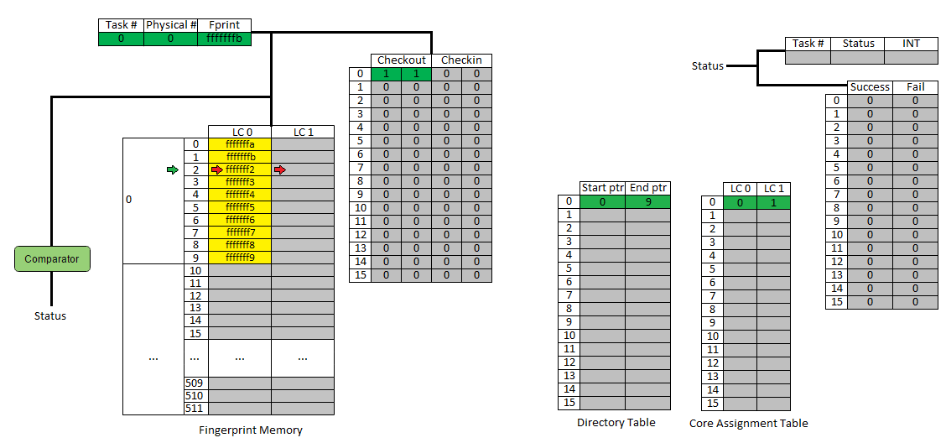
CFPU: What’s the problem?

Slide 95

CFPU: What’s the problem?

Slide 96

CFPU: What’s the problem?

Slide 97

CFPU: What’s the problem?

Slide 98

CFPU: What’s the problem?

Slide 99

CFPU: What’s the problem?

Slide 100
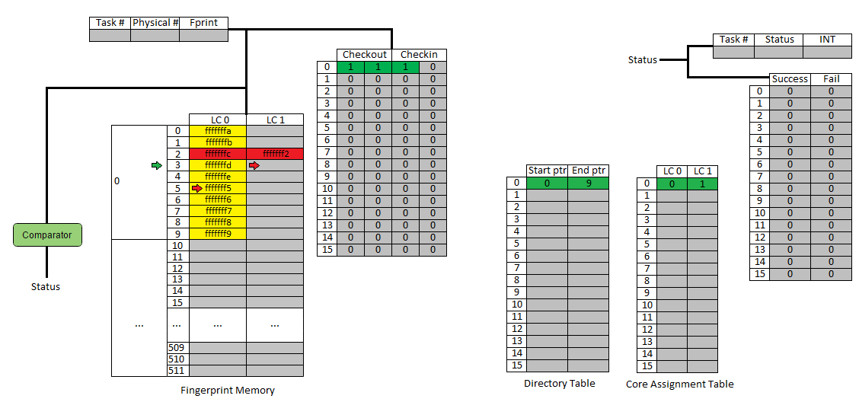
CFPU: What’s the problem?

Slide 101
CFPU: What’s the problem?

Slide 102
CFPU: What’s the problem?
Overflow!
Needs to be addressed at the source (i.e. core producing fingerprints)
How?
Send an interrupt to the core to pause task execution when it nears its directory limit
Send another interrupt to resume task execution once all the fingerprints belonging to that core have been compared

Slide 103
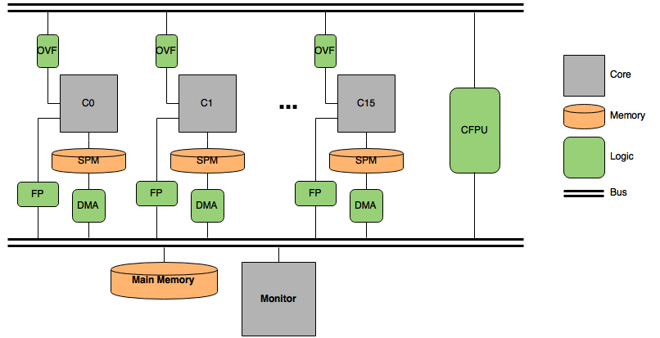
Modified System

Slide 104
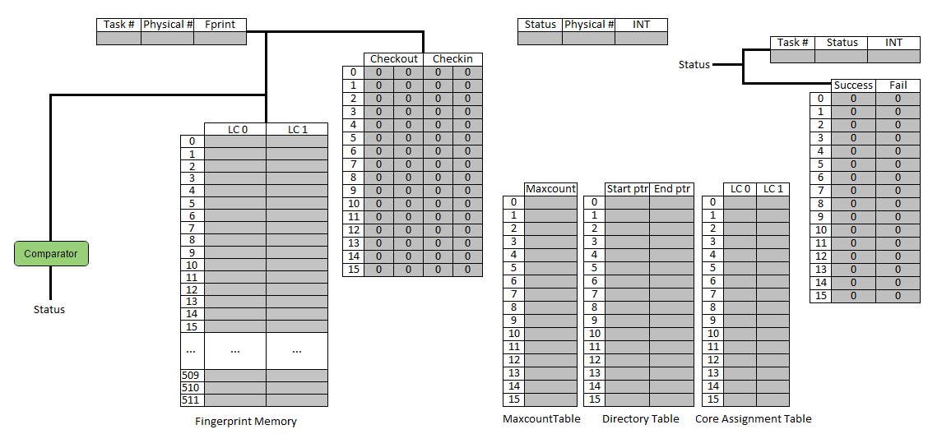
Modified CFPU

Slide 105
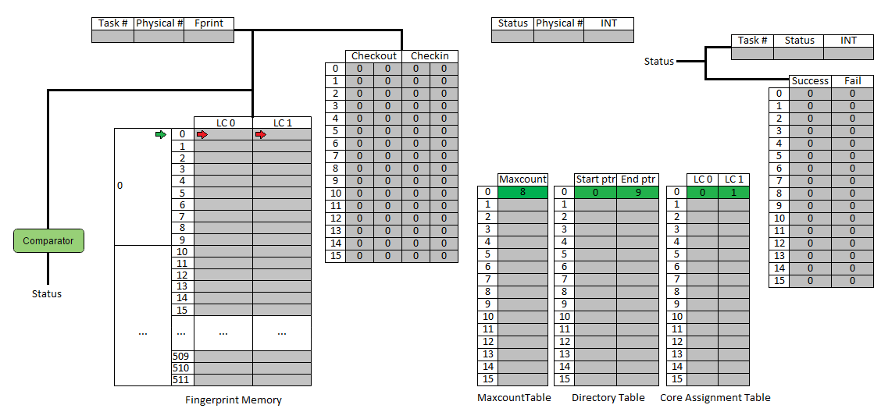
Modified CFPU

Slide 106
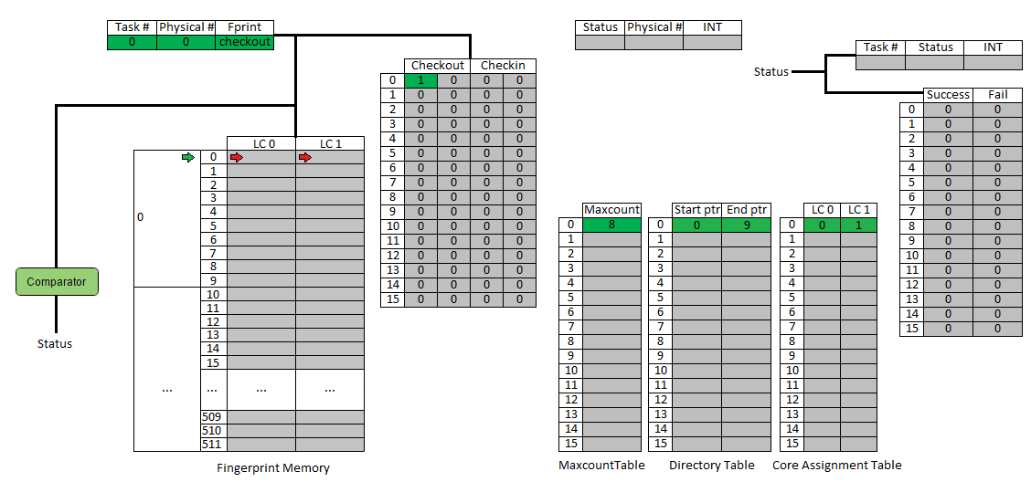
Modified CFPU

Slide 107

Modified CFPU

Slide 108
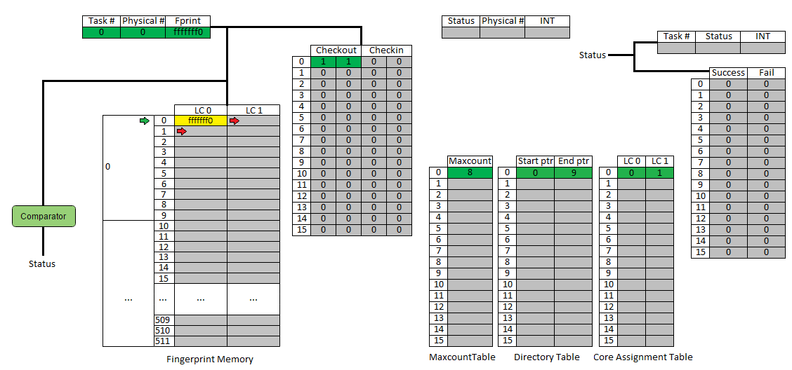
Modified CFPU

Slide 109
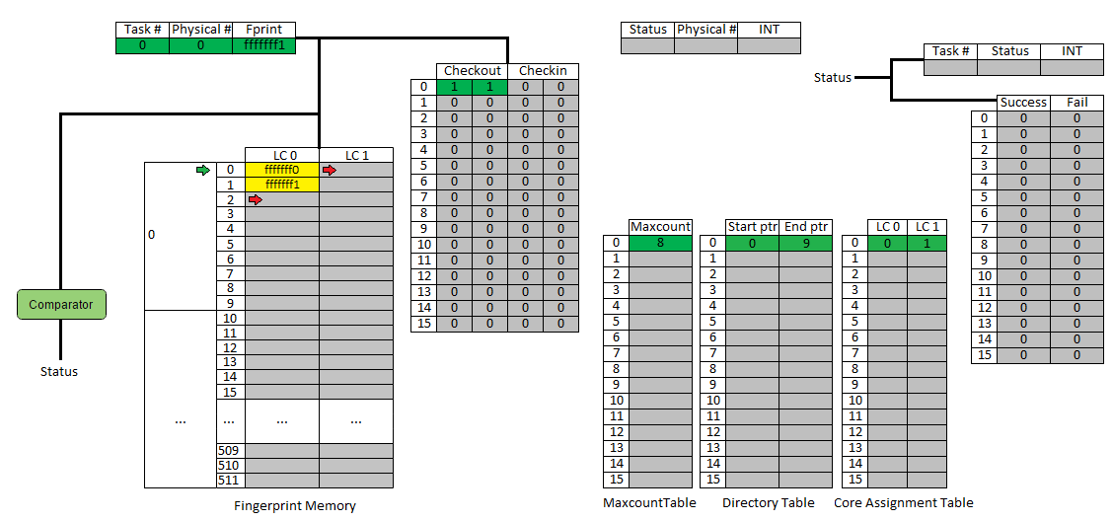
Modified CFPU

Slide 110

Modified CFPU

Slide 111
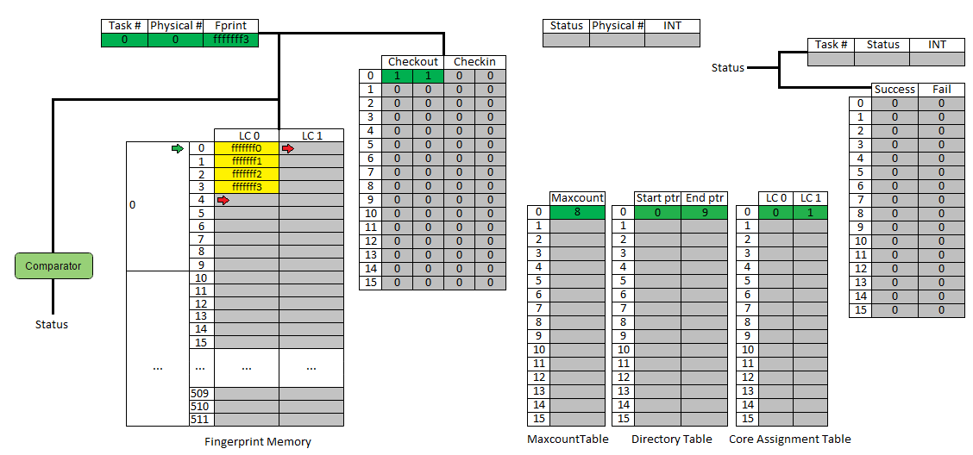
Modified CFPU

Slide 112

Modified CFPU

Slide 113

Modified CFPU

Slide 114

Modified CFPU

Slide 115

Modified CFPU

Slide 116

Modified CFPU

Slide 117

Modified CFPU

Slide 118

Modified CFPU

Slide 119

Modified CFPU

Slide 120

Modified CFPU

Slide 121

Modified CFPU

Slide 122

Modified CFPU

Slide 123

Modified CFPU

Slide 124

Modified CFPU

Slide 125

Modified CFPU

Slide 126

Modified CFPU

Slide 127

Modified CFPU

Slide 128

Modified CFPU

Slide 129

Modified CFPU

Slide 130

Modified CFPU

Slide 131

Modified CFPU

Slide 132

Modified CFPU

Slide 133

Modified CFPU

Slide 134

Modified CFPU

Slide 135

Modified CFPU

Slide 136

Modified CFPU

Slide 137

Modified CFPU

Slide 138

Modified CFPU

Slide 139

Modified CFPU

Slide 140

Modified CFPU

Slide 141

Modified CFPU

Slide 142

Modified CFPU

Slide 143

Modified CFPU

Slide 144

Modified CFPU

Slide 145

Modified CFPU

Slide 146

Modified CFPU

Slide 147

Modified CFPU

Slide 148

Modified CFPU

Slide 149

Modified CFPU

Slide 150

Modified CFPU

Slide 151

Modified CFPU

Slide 152

Modified CFPU

Slide 153

Modified CFPU

Slide 154

Modified CFPU

Slide 155

Modified CFPU

Slide 156

Modified CFPU

Slide 157

Modified CFPU

Slide 158
Results
Vary blocksize
Vary directory size
Vary task (type, length)
Discuss behavior when maxcount = directory size (fprint buffer)
Multiple tasks in parallel

Slide 159
TMR
Discuss additions
Results (same as before, and different tasks with DMR and TMR simultaneously)

